Slide 1
ICS 141 – Programming With Objects
Lecture 8 – Robert Jahn

Slide 2
Interfaces
What is an interface?
Why is an interface useful?
How do you define an interface?
How do you use an interface?

Slide 3
What is an interface? Why is an interface useful?
An interface is a class like construct that contains only constants and abstract methods. In many ways, an interface is similar to an abstract class, but the intent of an interface is to specify behavior for objects. For example, you can specify that the objects are comparable, edible, cloneable using appropriate interfaces.

Slide 4
Define an Interface
To distinguish an interface from a class, Java uses the following syntax to define an interface:
public interface InterfaceName {
constant declarations;
method signatures;
}
Example:
public interface Edible {
/** Describe how to eat */
public abstract String howToEat();
}

Slide 5
Interface is a Special Class
An interface is treated like a special class in Java.
Like an abstract class, you cannot create an instance from an interface using the new operator, but in most cases you can use an interface more or less the same way you use an abstract class.
For example, you can use an interface as a data type for a variable, as the result of casting, and so on.
One major difference is that we can implement multiple interfaces.
This allows us to mimic multiple inheritance.

Slide 6
Example
You can now use the Edible interface to specify whether an object is edible. This is accomplished by letting the class for the object implement this interface using the implements keyword. For example, the classes Chicken and Fruit implement the Edible interface.

Slide 7

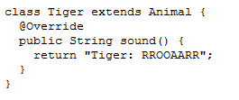
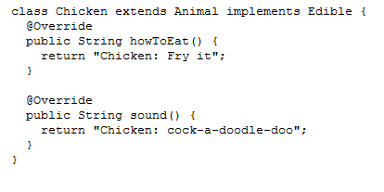
public interface Edible {
/** Describe how to eat */
public abstract String howToEat();
}

Slide 8

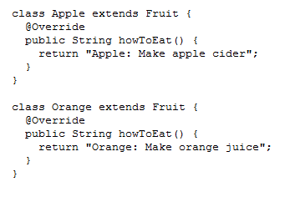
public interface Edible {
/** Describe how to eat */
public abstract String howToEat();
}

Slide 9
Omitting Modifiers in Interfaces
All data fields are public final static and all methods are public abstract in an interface. For this reason, these modifiers can be omitted, as shown below:
A constant defined in an interface can be accessed using syntax InterfaceName.CONSTANT_NAME (e.g., T1.K).

Slide 10
Interfaces vs. Abstract Classes
In an interface, the data must be constants; an abstract class can have all types of data.
Each method in an interface has only a signature without implementation; an abstract class can have concrete methods.
 | Variables | Constructors | Methods
Abstract class | No restrictions | Constructors are invoked by subclasses through constructor chaining. An abstract class cannot be instantiated using the new operator. | No restrictions.
Interface | All variables must be public static final | No constructors. An interface cannot be instantiated using the new operator. | All methods must be public abstract instance methods

Slide 11
Interfaces vs. Abstract Classes, cont.
All classes share a single root, the Object class, but there is no single root for interfaces. Like a class, an interface also defines a type. A variable of an interface type can reference any instance of the class that implements the interface. If a class implements an interface, this interface plays the same role as a superclass. You can use an interface as a data type and cast a variable of an interface type to its subclass, and vice versa.
Suppose that c is an instance of Class2. c is also an instance of Object, Class1, Interface1, Interface1_1, Interface1_2, Interface2_1, and Interface2_2.

Slide 12
Caution: conflict interfaces
In rare occasions, a class may implement two interfaces with conflict information (e.g., two same constants with different values or two methods with same signature but different return type). This type of error will be detected by the compiler.

Slide 13
Whether to use an interface or a class?
Abstract classes and interfaces can both be used to model common features. How do you decide whether to use an interface or a class? In general, a strong is-a relationship that clearly describes a parent-child relationship should be modeled using classes. For example, a staff member is a person. So their relationship should be modeled using class inheritance. A weak is-a relationship, also known as an is-kind-of relationship, indicates that an object possesses a certain property. A weak is-a relationship can be modeled using interfaces.

Slide 14
Interfaces
To this point, we’ve discussed interfaces as they have been through JDK 7.
In JDK 8, we introduced a minor, but important change, when it comes to interfaces.
JDK 8 introduced the idea of the default method. A default method is one we define in an interface. Instead of being a simple declaration, it serves as a method with a default implementation that may or may not be overridden later.

Slide 15
Interfaces
Why did java introduce the default method? Let’s look at an example.

Slide 16
The equals Method
The equals() method compares the contents of two objects. The default implementation of the equals method in the Object class is as follows:
public boolean equals(Object obj) {
return (this == obj);
}
Invoking this method would involve the use of the dot operator.
object1.equals(object2);

Slide 17
The equals Method
What is this equals method doing? We see that it compares the two object’s reference variables with the == operator.
This checks to see if the two reference variables point to the same object in memory. That is, it checks to see if these two reference variables are pointing to the exact same object. It does not check whether certain properties of the object are equal.
For this reason, much like the toString() method, it is always a good idea to override the equals method in your user-defined classes.

Slide 18
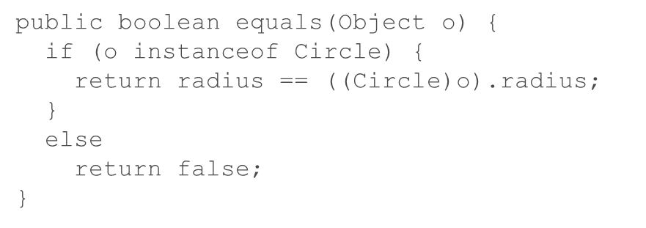
equals
For instance, consider a Circle class. What properties would we want to check in an equals method?
Radius? This is logical as two circles with the same radius will be the same size.

Slide 19
Exercise #9a

Slide 20
ArrayList
You can create an array to store objects. But the array’s size is fixed once the array is created. Java provides the ArrayList class that can be used to store an unlimited number of objects.
We have dealt with this fact through a few of the labs/assignments. We have handled it by including that counter variable to keep track of the actual amount of objects added/created.

Slide 21
The ArrayList Class

Slide 22
ArrayList
The ArrayList class is a very nice change of pace from the normal array.
The class/object itself keeps track of all of the size questions.
It will automatically keep a dynamic size as we alter the ArrayList object.
It will reduce the size when we remove an element.
It will increase the size as we add elements.

Slide 23
ArrayList
One caveat to keep in mind here ~
With arrays, we could have arrays of anything.
Primitive types
Reference types
With ArrayLists, we can only store reference types.
So, we can’t store ints, doubles, chars, etc…
Instead, we’d store the wrapper objects for these primitive types.
Integer, Double, Character, etc…

Slide 24
ArrayList Syntax
How do we create an ArrayList object? Let’s compare to a normal array.
Student[] array = new Student[30];
ArrayList<Student> array = new ArrayList<Student>();
Note the difference. For a normal array, we specify a size upon creation, 30.
For an ArrayList, the size will initially be 0 as we don’t have anything stored upon initial creation.
For the normal array, the size will be a static 30.
For the ArrayList, the size will change as we add/remove elements to/from the ArrayList object.

Slide 25
ArrayList Syntax
Generic syntax
ArrayList<T> refVar = new ArrayList<T>();
This is really our first dose of generic/template programming in action other than the polymorphic reference variables we have been using.
The T here can be replaced with any type of class in Java.
ArrayList<Dog> dogs = new ArrayList<Dog>();

Slide 26
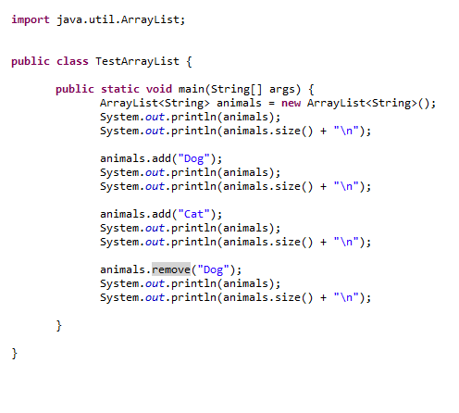
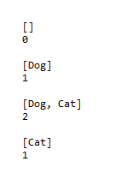
ArrayList Syntax

Slide 27
Changing Gears The singleton design pattern
Let us ask ourselves a question. How would we go about not allowing a class to be instantiated from outside the class definition. That is, how would we not allow objects to be created from outside the class definition.

Slide 28
Changing Gears The singleton design pattern
“Why would we want to do this?”, You might have asked yourself. What good is a constructor if we cannot use it to create objects of the class from outside the class definition.
Consider the following idea. What if we only ever want a single instance of a class to exist at any given time (Within the scope of an executing program)? Could we use the idea of a private constructor to accomplish this?

Slide 29
Changing Gears The singleton design pattern
To do something along these lines, we’ll have to make a couple of considerations. First, let’s discuss the strategy.
We want to create a private constructor in our class. As you know, this means that we cannot access this constructor from outside of that particular class definition.
We then want to create an instance of the class as a private/static data field within the same class. The idea here is that we want to hold the single instance of our class within the class itself. Note that this is a form of composition. This field will initially be set to null.
Finally, we define the getInstance() method. This method will only use the private constructor when our instance of the class is null. If it is not null (meaning it has already been set using the private constructor), then do nothing and simply return the instance as it is.

Slide 30
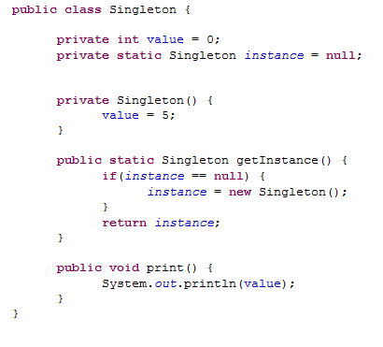
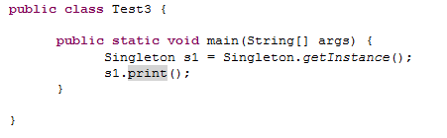
Changing Gears The singleton design pattern

Slide 31
Recursion

